Slide 1




AI RESUME & COVER LETTER
Presented by Swapnil Kesharwani
Institution: United College of Engineering & Research

Slide 2
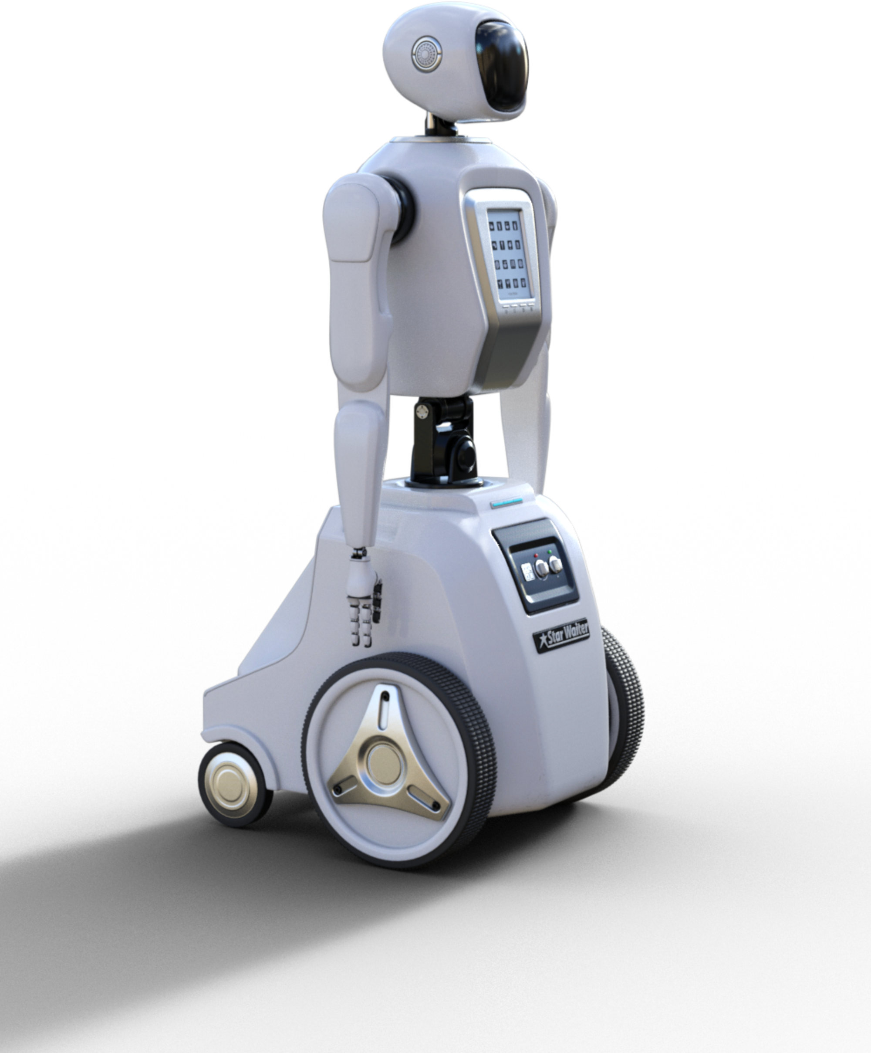

OVERVIEW
INTRODUCTION
WHAT IS AI RESUME & COVER LETTER
FEATURES
PROJECT OBJECTIVES
TECHNOLOGY USED
PROJECT SCOPE
METHODOLOGY
CONCLUSION
RESULT & ACHIEVEMENTS

Slide 3

INTRODUCTION
AI resumes and cover letters are becoming increasingly common, offering a streamlined approach to job applications using artificial intelligence. AI tools can analyze job descriptions, identify relevant skills, and generate tailored content for both resumes and cover letters, often saving time and effort for job seekers. However, it's crucial to understand that while AI can be a powerful assistant, it's not a replacement for human review and personalization.

Slide 4
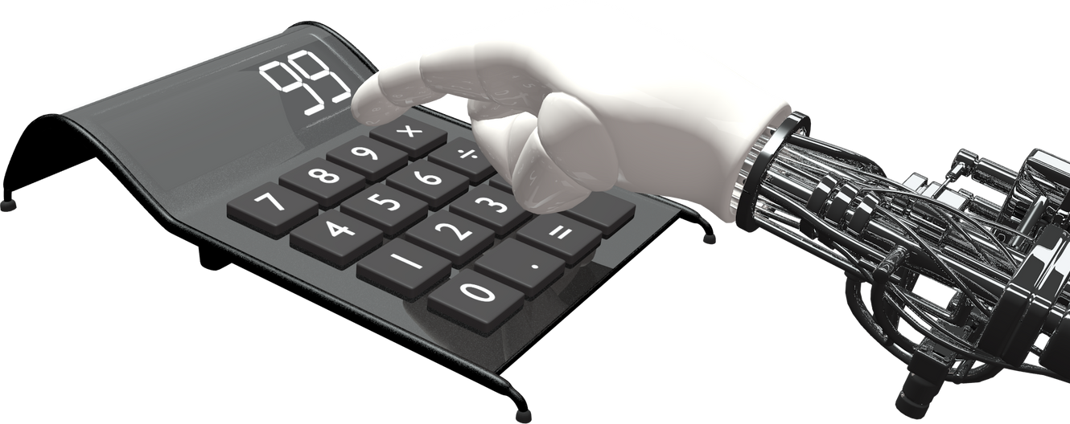
WHAT IS AI RESUME?
An AI resume is a resume created or enhanced using artificial intelligence technologies. AI resume tools—often called AI resume builders or generators—analyze job descriptions and user inputs (such as work history, skills, and education) to automatically generate tailored, professional resumes optimized for both human readers and Applicant Tracking Systems (ATS). These AI-powered platforms help job seekers quickly craft customized resumes that highlight relevant skills, experiences, and keywords specific to a job role.

Slide 5
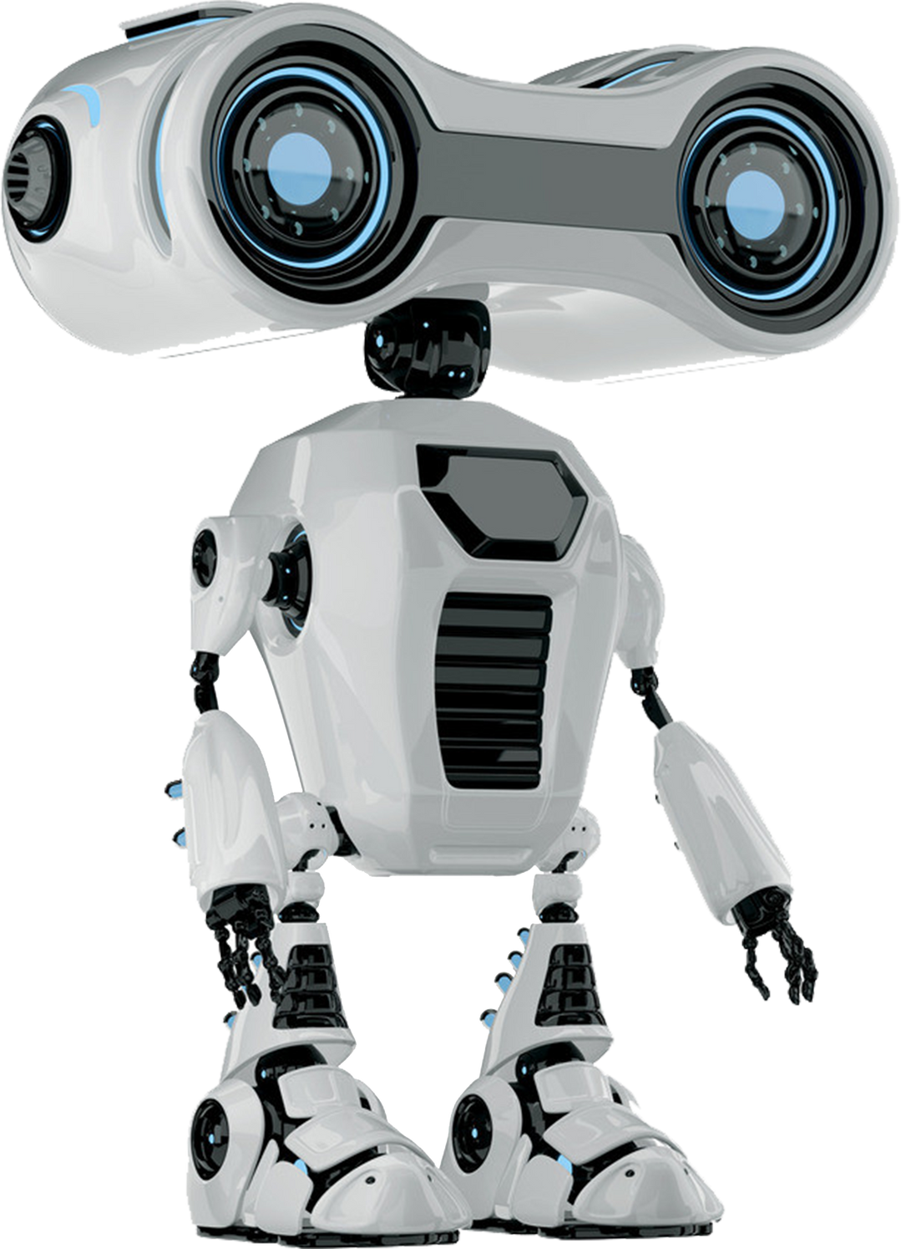
WHAT IS AI COVER LETTER?
An AI cover letter is a job application document generated with the help of artificial intelligence tools that use advanced algorithms—such as natural language processing (NLP) and machine learning—to quickly craft personalized, professional cover letters tailored to specific job descriptions and industries. Unlike traditional cover letters, which are manually written, AI cover letter generators analyze your resume, input job details, and relevant skills, then generate content that matches the job requirements and is optimized for both human reviewers and Applicant Tracking Systems (ATS)

Slide 6

FEATURES
1
2
3
4
Personalization & Tailoring :
Job Description Analysis
Skill & Keyword Optimization
Content Generation & Enhancement :
Automated Writing & Suggestions
Real-time Feedback
ATS Compatibility :
ATS-Friendly Formatting
Error Detection and Professionalism :
Grammar & Style Checking
Professional Tone Adjustment

Slide 7
PROJECT OBJECTIVES
OBJECTIVE 01
OBJECTIVE 02
OBJECTIVE 03
Highly tailored: AI generators customize content to match specific job descriptions and industries, ensuring skills and achievements are directly aligned with employer expectations.
ATS-friendly: Documents are structured and worded to pass through Applicant Tracking Systems (ATS), helping candidates get noticed by recruiters and move forward in the hiring process.
Personalized yet editable: AI-generated drafts provide a strong starting point, but users can still customize and refine content to reflect their unique personality and experiences.

Slide 8
TECHNOLOGY USED
Language Model: transformers>=4.28
Deep Learning: torch >= 1.9
Tokenizer: tokenizers>=0.13.3,
sentencepiece>= 0.1.95
Serialization: protobuf>= 3.20.0
Web UI: Gradio
(Optional) PDF Export: reportlab/ weasyprint

Slide 9
PROJECT SCOPE

Slide 10
PERSONALIZATION
AI can analyze job descriptions and tailor resumes and cover letters, highlighting relevant skills and experiences.
OPTIMIZATION
AI tools can identify keywords and phrases that improve the chances of passing Applicant Tracking Systems (ATS).
EFFICIENCY
AI can automate the creation of multiple versions of resumes and cover letters, saving time and effort.
CONTENT GENERATION
AI can assist with drafting sections, suggesting relevant accomplishments, and even generating entire cover letters.

Slide 11
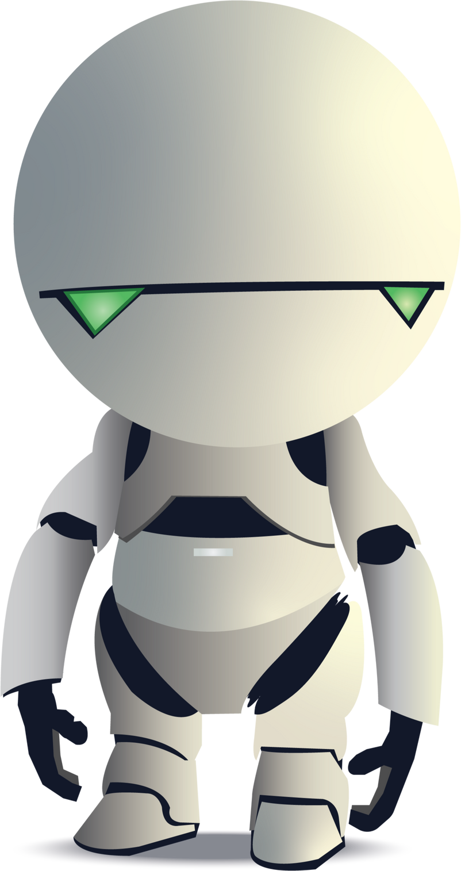
METHODOLOGY
1. Data Input and Analysis:
Job Description Analysis:
AI tools analyze the job description to identify key skills, qualifications, and keywords relevant to the specific role.
Resume Input:
Users input their resume, either by uploading a file or pasting content, providing the AI with a foundation of their experience and skills.
2. Content Generation:
Tailored Content:
Based on the analyzed data, the AI generates a tailored cover letter, potentially including a strong opening, relevant experience, and a compelling conclusion.
Keyword Optimization:
The AI incorporates keywords from the job description into the generated text, improving the application's visibility to Applicant Tracking Systems (ATS).
3. Customization and Personalization:
Personal Storytelling:
While AI can generate content, users are encouraged to personalize the text with their own stories, achievements, and unique experiences to make the application more authentic and memorable.
Voice and Style:
Users are advised to review and adjust the AI-generated text to match their own voice and communication style.

Slide 12
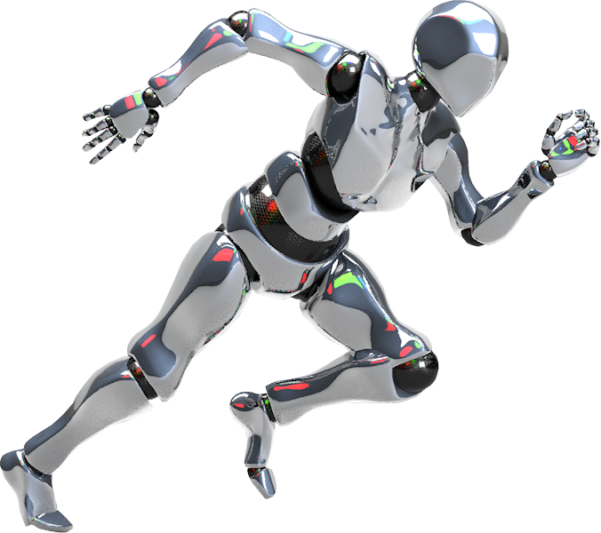
CONCLUSION
AI resume and cover letter generators have fundamentally transformed the job application landscape, empowering job seekers to quickly create highly personalized, professional, and ATS-optimized documents. By harnessing the power of large language models, advanced natural language processing, and intelligent design tools, these platforms streamline the creation process and boost the effectiveness of each application.

Slide 13
RESULT & ACHIEVEMENTS
PERSONALIZED AND TARGETED CONTENT:
AI TOOLS CAN ANALYZE JOB DESCRIPTIONS AND TAILOR RESUMES AND COVER LETTERS TO MATCH SPECIFIC REQUIREMENTS, HIGHLIGHTING RELEVANT SKILLS AND EXPERIENCES.
IMPROVED KEYWORD OPTIMIZATION:
AI CAN IDENTIFY AND INCORPORATE RELEVANT KEYWORDS FROM JOB POSTINGS INTO YOUR APPLICATION MATERIALS, INCREASING VISIBILITY WITH APPLICANT TRACKING SYSTEMS (ATS).
ENHANCED PRESENTATION AND READABILITY:
AI TOOLS CAN ASSIST IN FORMATTING RESUMES AND COVER LETTERS TO ENSURE A CLEAN, PROFESSIONAL, AND EASY-TO-READ LAYOUT.
QUANTIFIABLE ACHIEVEMENTS:
AI CAN HELP IDENTIFY AND PRESENT ACCOMPLISHMENTS WITH QUANTIFIABLE RESULTS (E.G., INCREASED EFFICIENCY BY X%, REDUCED COSTS BY Y%), MAKING YOUR APPLICATION MORE IMPACTFUL.

Slide 14
QUESTION AND ANSWER

Slide 15
THANK YOU

